Slide 1
A right to Rental assistance in massachusetts
December 2022

Slide 2
About Cspa
Founded in 2020, the Center for State Policy Analysis does detailed analysis of live legislative issues to:
Give lawmakers the information they need to improve their legislation
Help citizens understand — and productively debate — the stakes of new laws and ballot initiatives
Allow advocates to identify the most effective interventions
Notes:
And in this case, we were asked to examine the known benefits of MRVP and esitmate the costs of making the program universal

Slide 3
UNDERSTANDING RENTAL ASSISTANCE

Slide 4
background on mrvp
Massachusetts created the first rental voucher system in the US, and MRVP is still the largest state-funded program:
Think of it as a partnership to pay
MRVP once provided around 20,000 vouchers; now closer to 9,000
Federal “Section 8” program provides nearly 150,000

Slide 5
known benefits
Rental assistance has a legion of well-researched benefits:
Poverty alleviation
Homelessness reduction
Better health outcomes
Stability in the affordable housing market
Increased mobility

Slide 6
limitations of current system
The current MRVP system faces a number of challenges:
Scarcity: the majority of people elgible for MRVP don’t get vouchers
Landlord discrimination
Organizational inefficiency
Incomplete data collection

Slide 7
Universal RENTAL ASSISTANCE

Slide 8
Benefits of Universal mrvp
Making MRVP available to all who qualify could transform the landscape of affordable housing. It would:
Spread the benefits of MRVP to many more seniors, families, and individuals with very low incomes
Eliminate the unfairness of the lottery and wait list
Reduce landlord discrimination
Create new incentives to construct housing for voucher-holders

Slide 9
Who would benefit
Approximately 585,000 households in Massachusetts meet the current eligibility criteria for MRVP rental assistance.
Offering vouchers to all eligible families would advance core priorities like:
Racial justice
Economic justice
Regional fairness
Caring for seniors
Notes:
Our estimates suggest that nearly half of all eligible families have incomes below 30 percent of the area median income. That’s $25,450 in the Berkshires, and $37,850 in Boston.
Fully half of all the one-person households eligible for universal MRVP are people over 60 years old. By comparison, the typical head of an eligible three-person household is 39 years old.

Slide 10
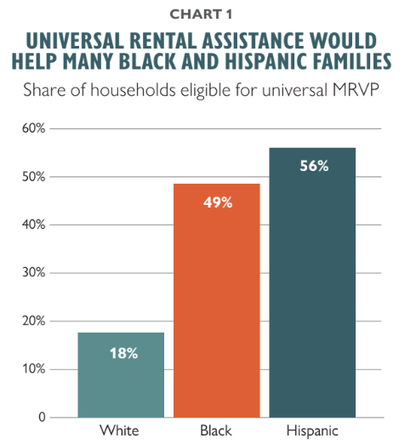
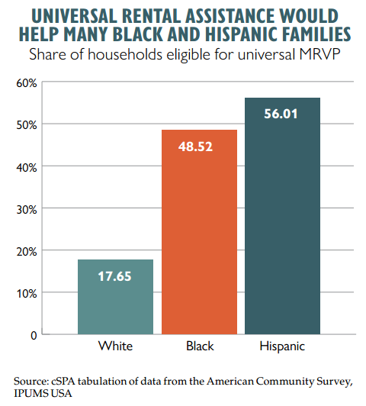
Racial justice implications
Nearly half of Black families and 56 percent of Hispanic families in Massachusetts are eligible for rental assistance.
Guaranteeing vouchers for all would dramatically ease the cost burden for renters of color, creating new opportunities to invest in other priorities like businesses or family needs.
Notes:
This is a measure of capacity. Lots of options here but they all tell the same story

Slide 11
Costs of Universal mrvp 1/2
For a cost estimate, we took the following approach:
Identify all households eligible (585k)
Adjust to account for households already served by the current array of rental programs (335k)
Further adjust for incomplete participation and churn (240k)

Slide 12
Costs of Universal mrvp 2/2
Calculate the average cost for each new vouchers (~$1000/month)
Add administrative costs, calculated from Section 8 reimbursement rates and accounting for likely economies of scale (~$100/month)
Bringing this all together, we conclude that a universal rental assistance program could help 240,000 new households at an annual cost of $3.2 billion.
Notes:
building off the known cost of current MRVP vouchers, current rent limits, and the income of potentially-eligible families. We find average monthly costs of $1,000 per voucher.

Slide 13
RISKS AND CHALLENGES
A policy leap of this scale would require vigilant attention to certain risks:
Keeping rents in check
Ensuring access to jobs and opportunities
Minimizing competition with federal programs
Notes:
household formation
cliffs (keeping the 80% threshold)

Slide 14
GETTING FROM HERE TO UNIVERSAL
A change of this scale will require thoughtful preparation, a gradual phase-in, and an iterative process:
Moving in phases
Re-organization and codification
New construction
Notes:
25k per year over 10 years (or tiers of eligibility)
integrating into general laws and centralizing oversight

Slide 15
Comments and Questions Welcome
Evan Horowitz, evan.horowitz@tufts.edu
December 2022

